Slide 1

NATIONAL AND KAPODISTRIAN UNIVERSITY OF ATHENS
Department of Economics
M.Sc. in Business Administration, Analytics and Information Systems
Master Thesis
Machine Learning Approaches For Heart Disease Classification and Implementation in Python
Athens 2024
Author: Koukas Athanasios Supervisor: Dr. Demetriou Ioannis

Slide 2
Structure of presentation
Introduction
Aim
Methodology
Dataset Characteristics
Initial look at the features
Numerical Features Analysis
Categorical Features Analysis
Data Preprocessing
Algorithms Training Phase
Algorithms Testing Phase
Comparison of Models
Conclusions
Limitations and Recommendations for Future Research

Slide 3
Introduction
Cardiovascular Disease (CVD) is defined as any disease of the heart and its associated blood vessels
(World Health Organization, 2021).
CVDs are the number one global cause of mortality, claiming an estimated 17.9 million lives annually.
Over 80% of CVD-related fatalities result from heart attacks and strokes.

Slide 4
Aim
The aim of this thesis is to:
Implement six Machine Learning Algorithms for predicting the occurrence of heart disease.
Assess the efficacy of the models in detecting heart disease instances.

Slide 5
Methodology
The strategy employed in this thesis is as follows:
1. Remove missing (zero) values from the dataset.
2. Assess feature importance regarding the target variable.
3. Split the dataset with an 80-20 ratio, allocating 80% of the samples for training and 20% for testing.
4. Create two scaled data frames. One was scaled through Normalization and the other through Standardization. The algorithms were trained and tested on both data frames.
5. Implement six ML algorithms: kNN, Logistic Regression, Naïve Bayes Gaussian, Naïve Bayes Bernoulli, Decision Tree, and Random Forest.
6. Tune the hyperparameters to maximize the Recall Score.

Slide 6
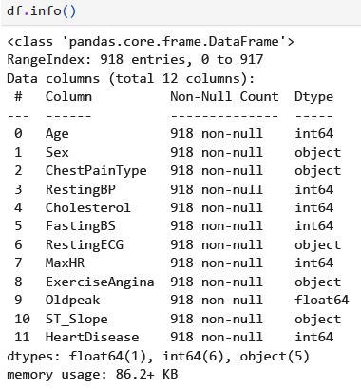
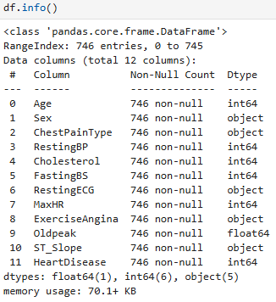
Dataset Characteristics
The thesis Dataframe (Kaggle), contains eleven features and the binary target variable denoting the heart disease presence. From this table, we see more about the dataset.
After removing samples with missing values

Slide 7
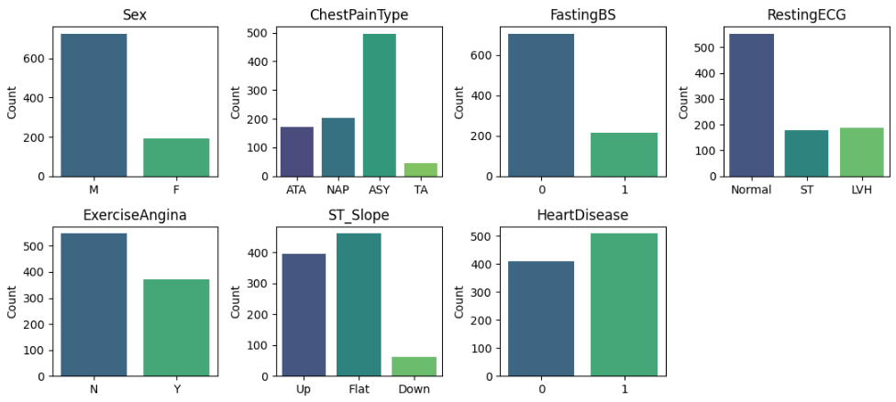
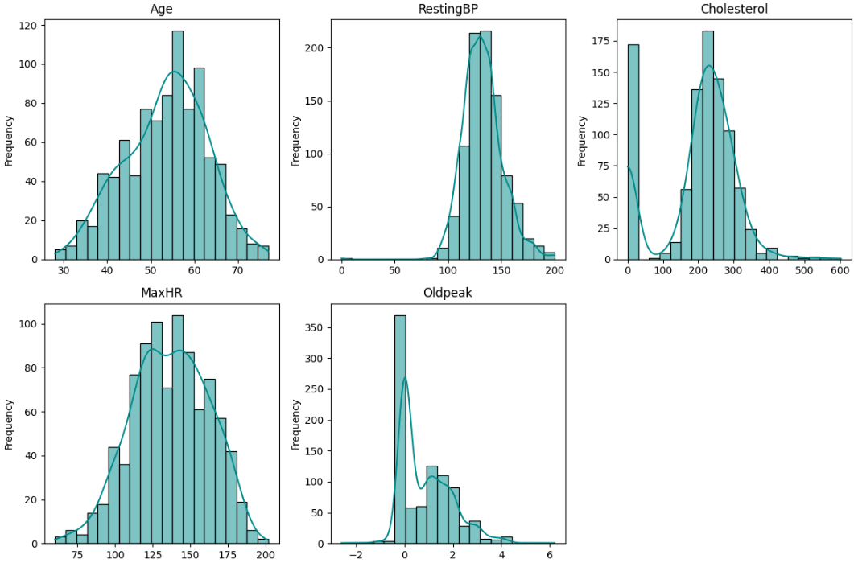
Initial look at the features
Important Insights from these graphs:
We can detect some zero values in the "RestingBP“ and “Cholesterol” features.
The dataset is almost evenly balanced regarding the target variable, HeartDisease.

Slide 8
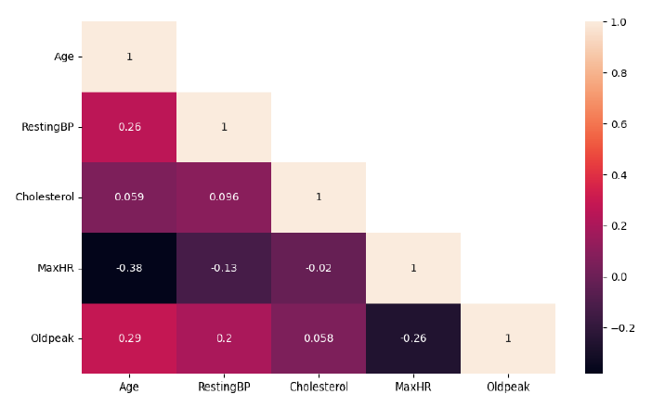
Numerical Features: Pairwise Correlations
Through pairwise correlations (Pearson's r), we found no collinearity issues, as none of the variable pairs exhibited very high correlation.

Slide 9
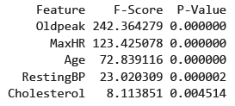
Numerical Features: Statistical Significance
Based on the ANOVA F statistics and their corresponding p-values, we noted that all numerical features are statistically significant at both 5% and 1% significance levels.

Slide 10
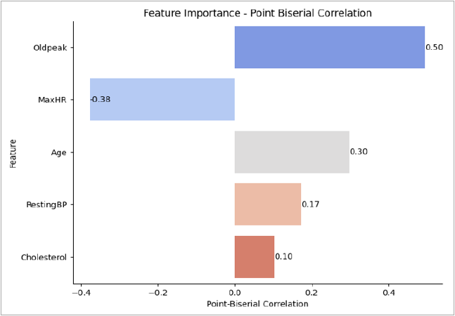
Numerical Features: Feature Importance
We assessed feature importance for every feature against the target variable. The most correlated features, in absolute values, were Oldpeak, followed by MaxHR and Age.

Slide 11
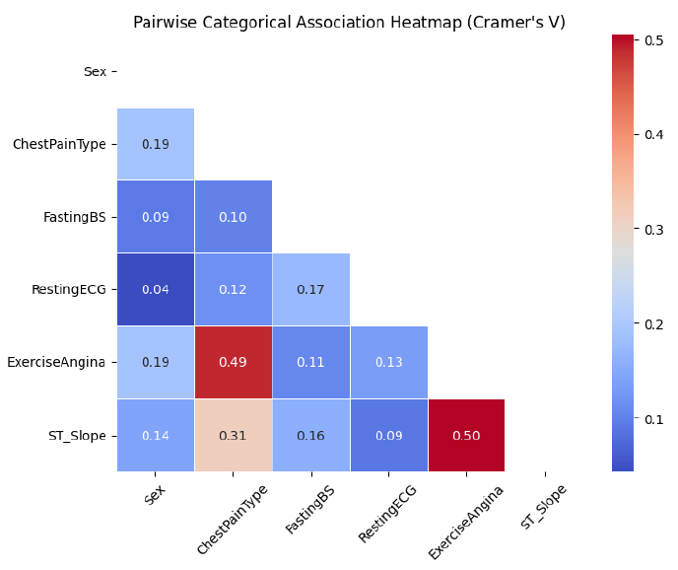
Categorical Features: Pairwise Associations
Through pairwise Associations (Cramer’s V), we found that none of the variable pairs exhibit a very high association.

Slide 12
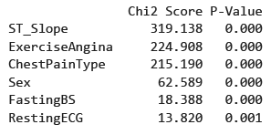
Categorical Features: Statistical Significance
Based on the Chi Square Scores and their corresponding p-values, we noted that all categorical features are statistically significant at a 5% significance level.

Slide 13
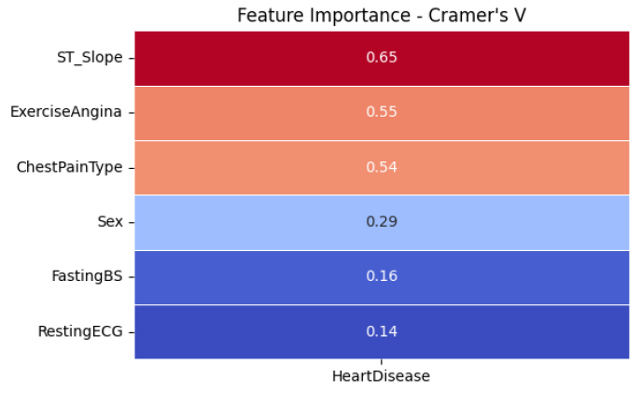
Categorical Features: Feature Importance
We assessed feature importance using Cramer's V for every categorical feature against the target variable. The most associated features were ST_Slope followed by ExerciseAngina and ChestPainType.

Slide 14
Data Preprocessing
The methodology followed for Data Preprocessing is as follows:
We encode the categorical features with “One hot encoding”, to convert categorical data into a format that machine learning algorithms can understand.
To avoid data leakage, we split the dataset into train and test set before scaling the data. The ratio of splitting is 80% – 20%.
We scale the data with Normalization and Standardization.
Now, we have three data frames ready to be fed to the algorithms.
Unscaled Dataframe
Normalized Dataframe
Standardized Dataframe

Slide 15
Algorithms - Training Phase
Training Phase by the following algorithms:
kNN
Logistic Regression
NBC Gaussian
NBC Bernoulli
Decision Tree
Random Forest
The methodology followed for training the algorithms is as follows:
Step 1: Apply “GridSearchCV”, on the training set, to obtain the optimal hyperparameters.
Step 2: Fit the model with the optimal hyperparameters found from step 1.
Step 3: Print the training set Recall score.
Step 4: Use 5-fold Cross Validation to obtain Recall scores for each fold and the average Recall score.
Step 5: Visualize the performance through Confusion Matrix.

Slide 16
Algorithms - Testing Phase
In the Testing Phase, we use a separate test set to test and evaluate the trained algorithms.
The methodology followed for testing and evaluating the algorithms is as follows:
Step 1: Make predictions on the test set.
Step 2: Compute and print the Test Set Recall score.
Step 3: Visualize the performance through Confusion Matrix.
Step 4: Print all the evaluation metrics.
Step 5: Plot the ROC Curve.

Slide 17
Comparison of Models: Training Results
For the tables presented in the “Comparison of Models” Section, every value that is the best or second best in each row is colored green.
First, we compare the key metrics of the training phase, namely Accuracy and Recall scores.
Training Results
 | kNN | Log Regression | Log. Regression - Threshold = 0.40 | Naive Bayes Gaussian | Naïve Bayes Bernoulli | Decision Tree | Random Forest
Accuracy | 0.861 | 0.856 | 0.867 | 0.849 | 0.841 | 0.810 | 0.888
Recall (True Positive Rate) | 0.880 | 0.877 | 0.912 | 0.849 | 0.880 | 0.877 | 0.901
Logistic Regression with a modified threshold achieves the highest Recall score of 0.912, suggesting its effectiveness in identifying positive cases. It also achieves the 2nd highest Accuracy of 0.867.
Random Forest achieves the highest Accuracy of 0.888, indicating its overall predictive power across both positive and negative cases. It also achieves the second highest Recall score of 0.901.

Slide 18
Comparison of Models: Cross Validation Results
Then, we compare the cross-validation scores, to assess the robustness of each model.
Cross Validation Training Recall Scores Analysis
 | kNN | Log Regression | Naive Bayes Gaussian | Naïve Bayes Bernoulli | Decision Tree | Random Forest
Fold 1 | 0.912 | 0.912 | 0.895 | 0.912 | 0.912 | 0.947
Fold 2 | 0.929 | 0.911 | 0.893 | 0.911 | 0.750 | 0.911
Fold 3 | 0.877 | 0.842 | 0.807 | 0.825 | 0.842 | 0.877
Fold 4 | 0.860 | 0.789 | 0.825 | 0.825 | 0.719 | 0.860
Fold 5 | 0.877 | 0.877 | 0.754 | 0.877 | 0.772 | 0.842
Average Recall | 0.891 | 0.866 | 0.835 | 0.870 | 0.799 | 0.887
Range | 0.069 | 0.123 | 0.141 | 0.087 | 0.193 | 0.105
St. Deviation | 0.025 | 0.046 | 0.054 | 0.039 | 0.069 | 0.037
The kNN algorithm demonstrates the best performance, boasting an average Cross-Validation Recall Score of 0.891, a Range of 0.069 and a St. deviation of 0.025.
The Random Forest algorithm demonstrates the 2nd best performance, with an average Cross-Validation Recall Score of 0.888, a Range of 0.105 and a St. deviation of 0.037.
This low variability across the 5-folds showcases the consistency of the algorithms, suggesting that the are robust.

Slide 19
Comparison of Models: Testing Results
Lastly, we compare the testing scores to see how the trained models perform on unseen data.
Testing Results
 | kNN | Log Regression | Log Regression - Threshold = 0.40 | Naive Bayes Gaussian | Naïve Bayes Bernoulli | Decision Tree | Random Forest
Accuracy | 0.893 | 0.900 | 0.880 | 0.913 | 0.894 | 0.827 | 0.887
Recall (True Positive Rate) | 0.917 | 0.889 | 0.917 | 0.917 | 0.903 | 0.875 | 0.903
Precision | 0.868 | 0.901 | 0.846 | 0.904 | 0.878 | 0.788 | 0.867
F1 Score | 0.892 | 0.895 | 0.880 | 0.911 | 0.890 | 0.829 | 0.885
AUC Score | 0.930 | 0.950 | 0.880 | 0.960 | 0.940 | 0.910 | 0.960
The "Naïve Bayes Gaussian" model exhibited slightly superior, or at least equal, performance compared to the other models across all metrics.
Following closely behind were the "Random Forest", "kNN", and “Naïve Bayes Bernoulli” models, which demonstrated satisfactory scores in every metric, with notably high Recall scores.
While results on unseen data are crucial for assessing how algorithms generalize, we should also take into consideration the robustness of each model that we assessed from the analysis of cross-validation scores.

Slide 20
Conclusions
Although the “Naïve Bayes Gaussian” model displayed the highest testing scores, it exhibited mediocre cross-validation scores during the training phase, with a Range of 14.1% and a St. deviation of 5.4%. This instability indicates that the model lacks robustness.
In contrast, the “Random Forest” and “kNN” models are more stable in overall performance.
The “Random Forest” model displayed high testing scores, across all metrics, and low variability across the 5-folds, with a Range of 10.5% and a St. deviation of 3.7%.
Similar high testing results showcased the “kNN” model, across all metrics, and low variability across the 5-folds, with a Range of 6.9% and a St. deviation of 2.5%.

Slide 21
Limitations and Recommendations for Future Research
In the association analysis conducted, certain features exhibit relatively weaker associations with the target variable (Heart Disease).
Cholesterol
As evidenced by the lower values in
Point Biserial Correlation
Fasting Blood Sugar
As evidenced by the lower values in
Cramer’s V
Resting Electrocardiogram Results
As evidenced by the lower values in
Cramer’s V
Potential Future Strategies | Limitations
Considering these insights, one might implement Feature Reduction | Domain Expertise
Imputation of the missing values | Domain Expertise
Models such as Support Vectors Machines or/and Neural Networks | None

Slide 22
Thank you for your attention

